Slide 1
Connect Four: Player, Solver, & Visualizer
Mikael Sabuhi
Omid Hajihassani
April 2019

Slide 2
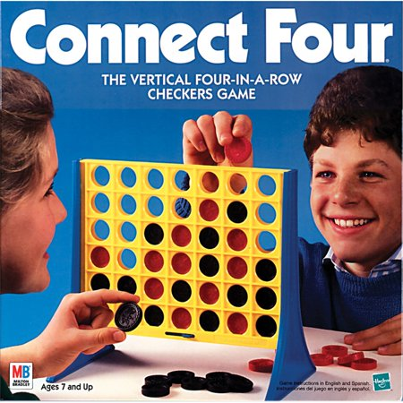
Connect Four game

Slide 3
The Connect Four gameplay
In the Connect Four game, two players choose a color and take turns to drop disks of their color into the game board.
The player that first connects disks of his color horizontally, diagonally, or vertically, wins the game.

Slide 4
A bit of history
The game was introduced and published in 1974 by Milton Bradley / Hasbro.
As the box of the game mentions the game is a Vertical Four-In-A-Row checkers game.

Slide 5
Cont’d
The Connect Four game is a game of perfect information where the game state is fully observable.
The Connect Four game has been fully solved.
The first player with optimal game play can win the game.
Can you think of the best first opening move?

Slide 6
This presentation
We intend to introduce and discuss our implementation of :
An interactive Connect Four Graphical UI.
Different Connect Four player approaches.
A Negamax Connect Four solver with different optimizations.

Slide 7
Solver ( NegaMax )
Quick Introduction to NegaMax

Slide 8
Negamax Solver
The Negamax search algorithm is a variant of the Minimax search algorithm.
Negamax can be utilized in two player games with the zero-sum property.
The zero-sum property states that as a player’s score gain is its opponent loss of score, the total sum of scores would be zero.

Slide 9
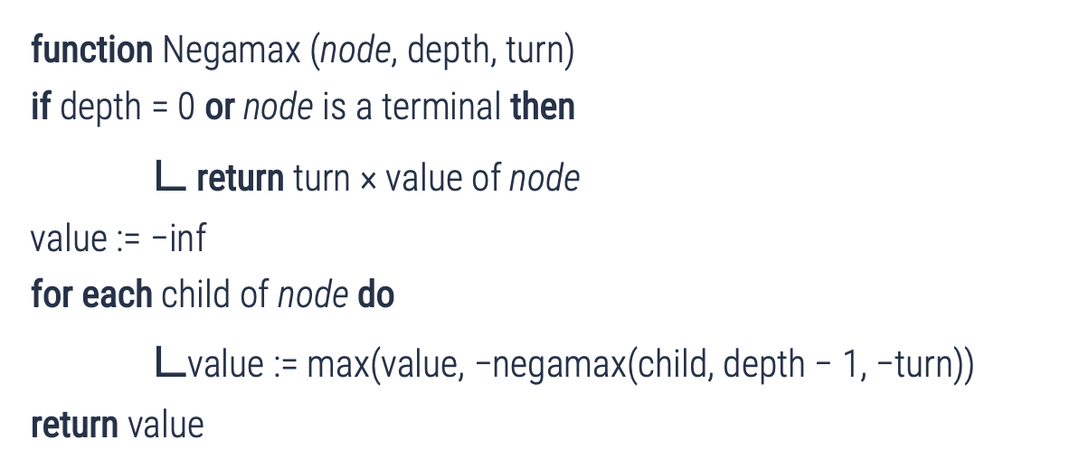
Negamax Algorithm
function Negamax (node, depth, turn)
if depth = 0 or node is a terminal then
$∟$ return turn × value of node
value := −inf
for each child of node do
$∟$value := max(value, −negamax(child, depth − 1, −turn))
return value

Slide 10
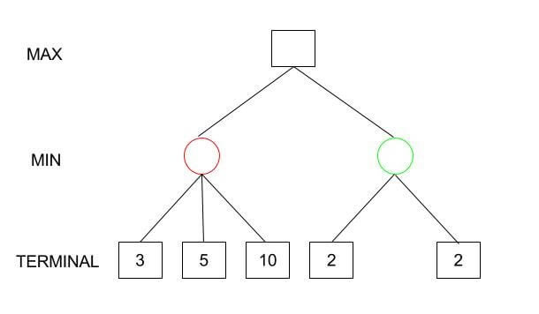
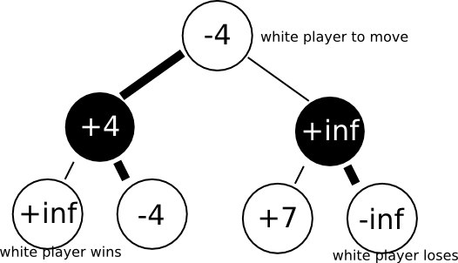
Minimax vs. Negamax
Minimax:
Negamax:
3
3
2

Slide 11
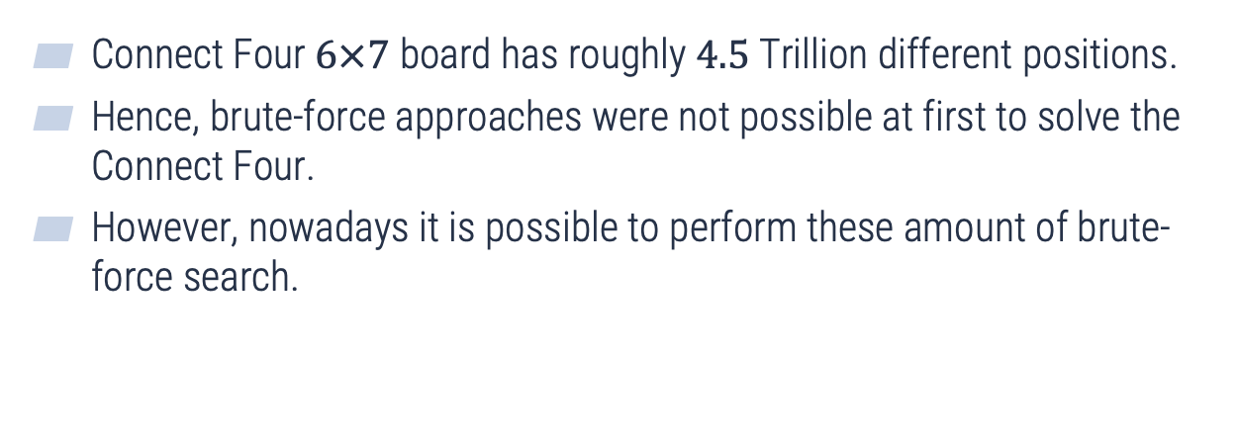
The difficulty of Connect Four
Connect Four $6×7$ board has roughly $4.5$ Trillion different positions.
Hence, brute-force approaches were not possible at first to solve the Connect Four.
However, nowadays it is possible to perform these amount of brute-force search.

Slide 12
Different implementations
Implementations:
Plain Negamax search.
Negamax search with Alpha-beta pruning.
Negamax search with Alpha-beta pruning and move-ordering.

Slide 13
Evaluation of methods
We have used the number of searched nodes per second for evaluation:
Negamax + Alpha-beta + M/O: Searches 24397 in 6.642 Seconds. 4Kpos/sec which searches the entire space.
Negamax + Alpha-beta: Searches 26277 in 8.465 Seconds. 3Kpos/sec which searches the entire space.
The Negamax + Alpha-beta + M/O outperforms Negamax + Alpha-beta by 1.07 percent which is roughly 7 percent improvement.

Slide 14
GUI ( Visualizer )
Quick Overview of the GUI

Slide 15

Pygame Library
Is a Free and Open Source Python Library
A good choice for 2D board Games

Slide 16
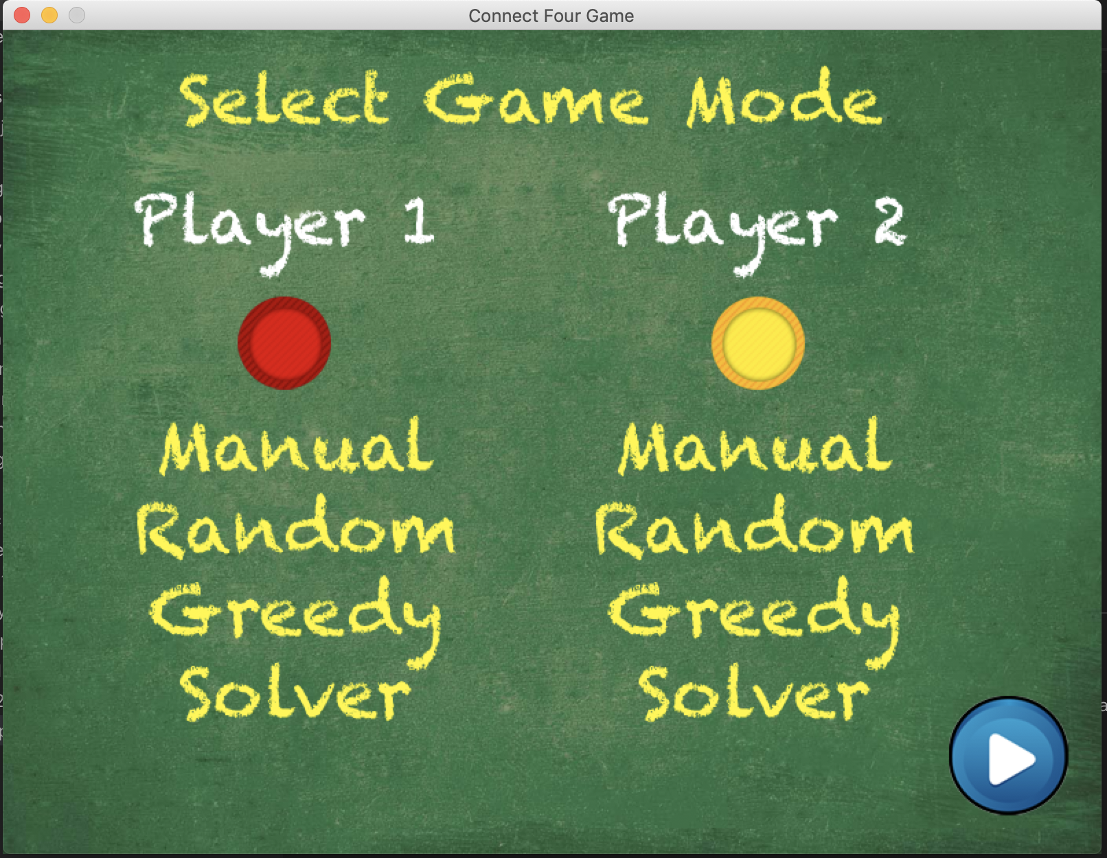
Play Mode
Manual Player
Random Player
Greedy Player
NegaMax Player

Slide 17
Manual Player
Players Decide Which one goes first and they take alternative turns.

Slide 18
Random Player
Computer Randomly selects a column to play from ( 1 to 7 )

Slide 19
Greedy Player
Two Goals :
Maximize her score
Prevent Opponent From Maximizing his Score
We need some features to extract

Slide 20
Extracted Features for Greedy Player
Features:
Number of Segments of 4 Disks
Number of Segments of 3 Disks
Number of Segments of 2 Disks
We assign a weight for each of these features
Score = Numberof2Disks*1 + Numberof3Disks*4 +Numberof4Disks*10000
Move_value = Score_after_valid_move – Score_current
Disks | Weight
1 | 0
2 | 1
3 | 4
4 | 10000

Slide 21
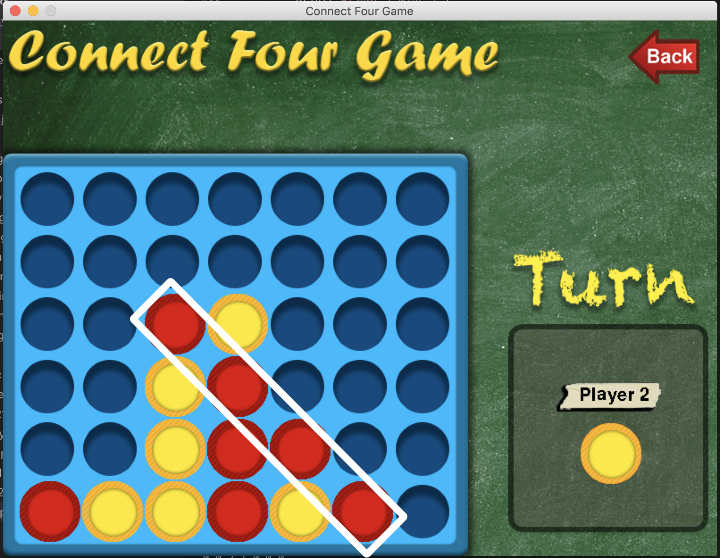
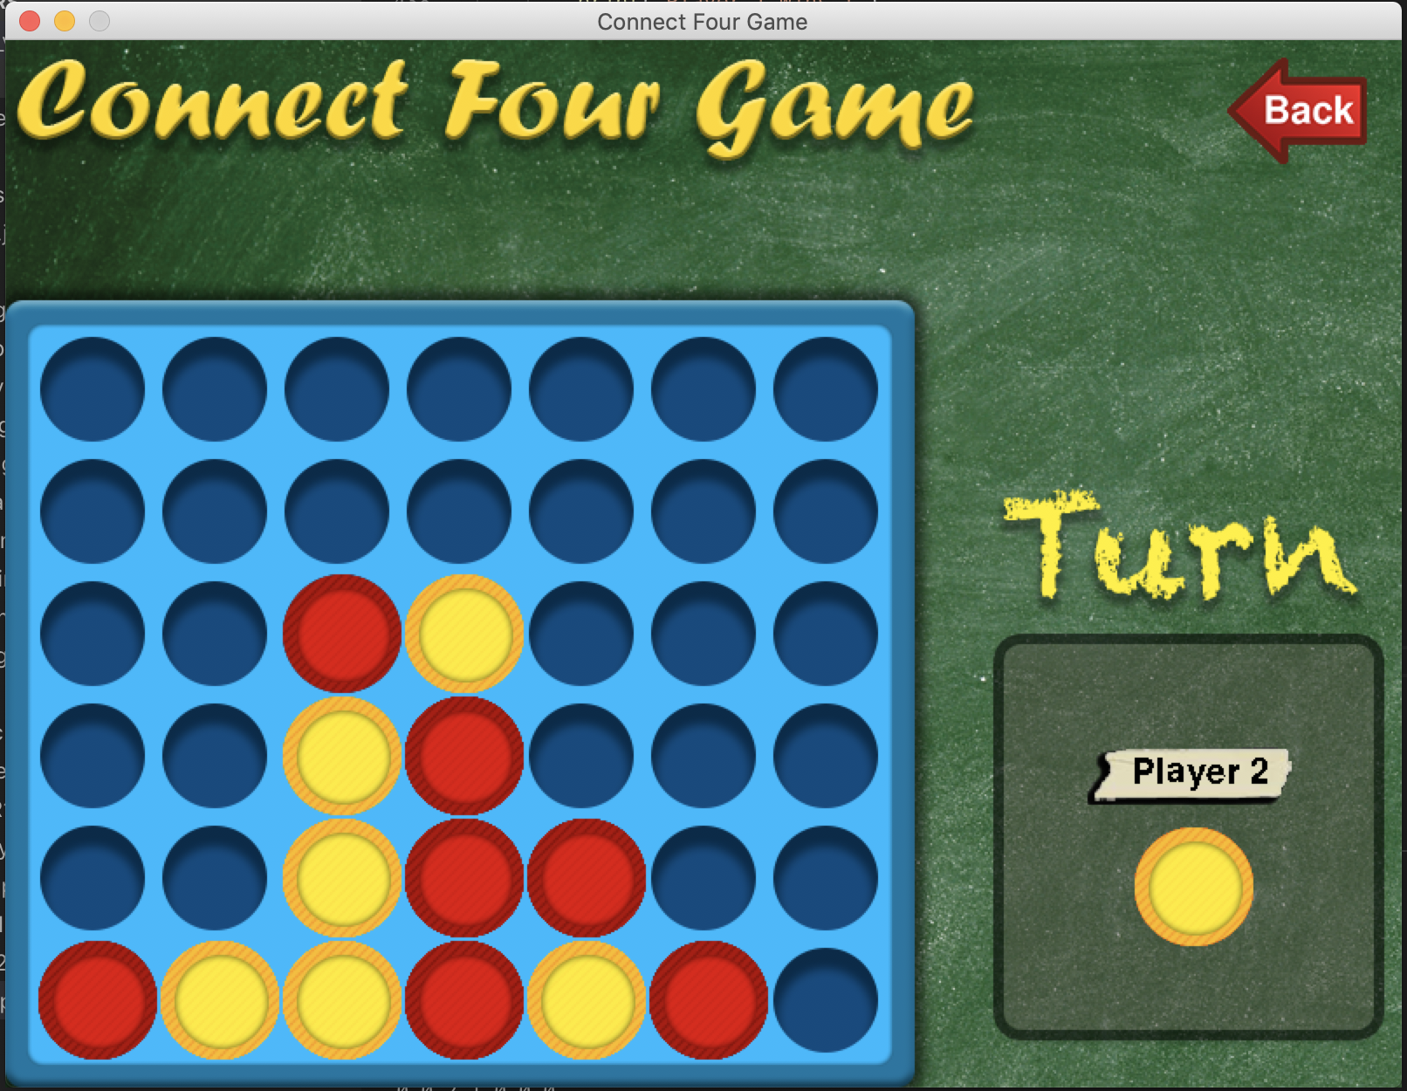
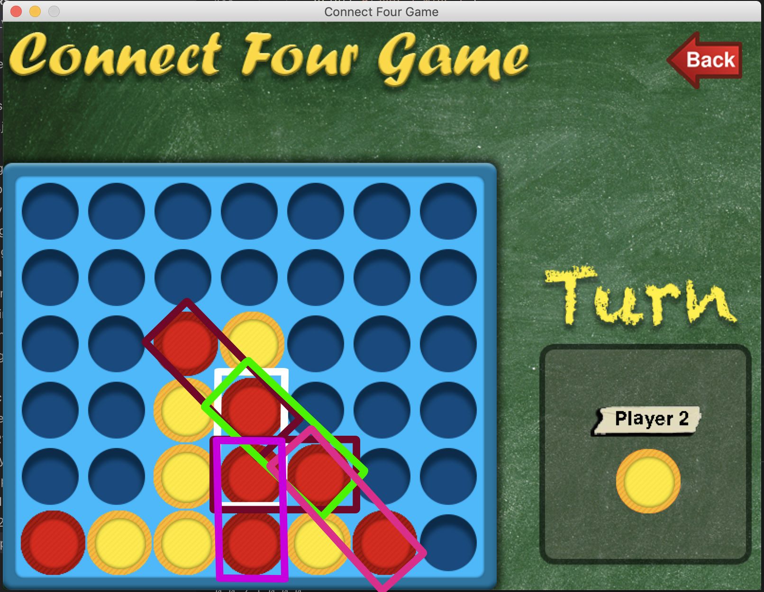
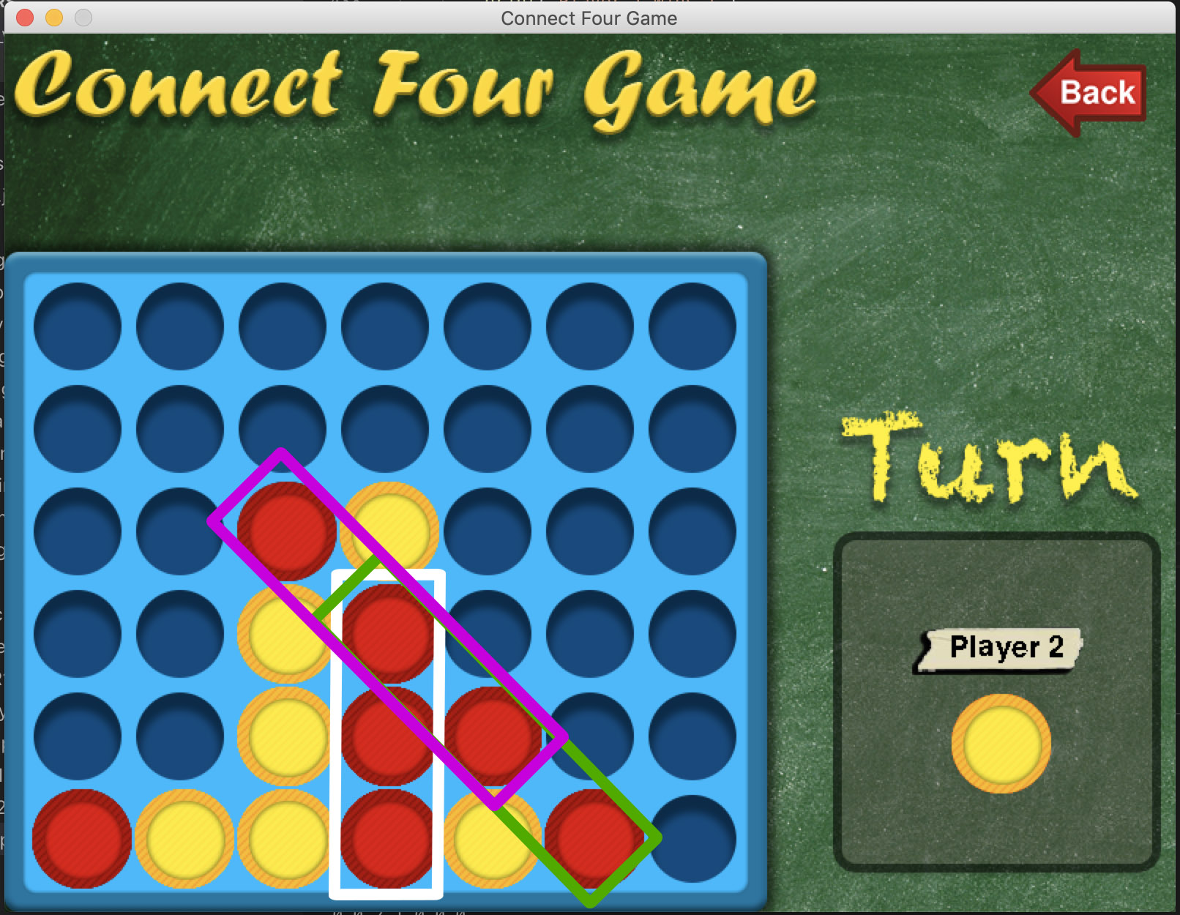
Segments
1 Segment with 4 Disks
6 segments with 2 Disks
Current Position
3 Segments with 3 Disks

Slide 22
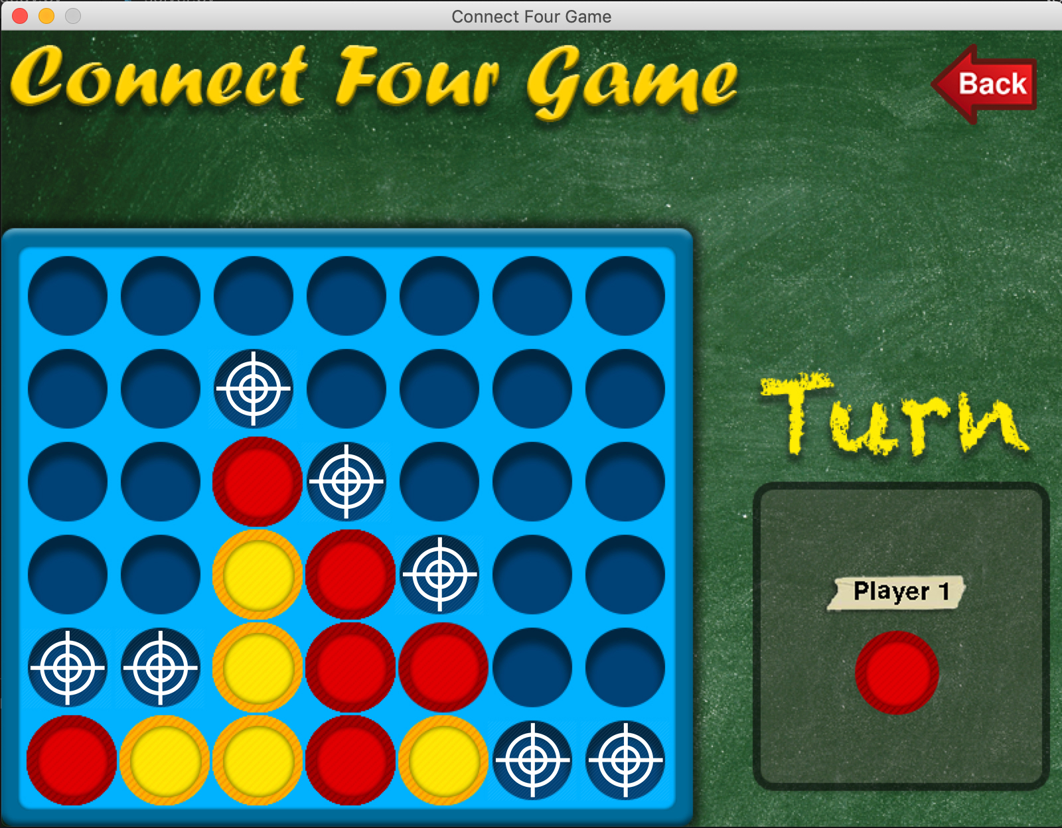
Greedy Algorithm
Algorithm:
Calculate the score for the player to move in current position
Calculate the score for each valid move of player
Calculate the Move_value Vector for player
Calculate the score for opponent current position
Calculate the score for each valid move of opponent
Calculate the Move_Value_Opponent vector for opponent
If MAX(Players_Move_Value) >= MAX(Opponent_Move_Value) select the move that maximizes the player score
If MAX(Players_Move_Value) <MAX(Opponent_Move_Value) select the move that prevents the opponent from maximizing his score.
Player_Move_Value = [1, 1, 1, 10006, 3, 10005, 0]
Opponent_Move_Value = [1, 4, 0, 1, 0, 1, 0]

Slide 23
Time to Test
Tournament

Slide 24
Results
Player 1 | VS | Player 2 | 1 Win | Draw | 2 Win
Random |  | Random | 5 | 0 | 5
 |  | Greedy | 0 | 0 | 10
 |  | Negamax(10) | 0 | 0 | 10
Greedy |  | Random | 10 | 0 | 0
 |  | Greedy | 4 | 0 | 6
 |  | Negamax(10) | 0 | 0 | 10
Negamax(10) |  | Random | 10 | 0 | 0
 |  | Greedy | 10 | 0 | 0
 |  | Negamax(10) | 0 | 10 | 0

Slide 25
Execution Time

Slide 26
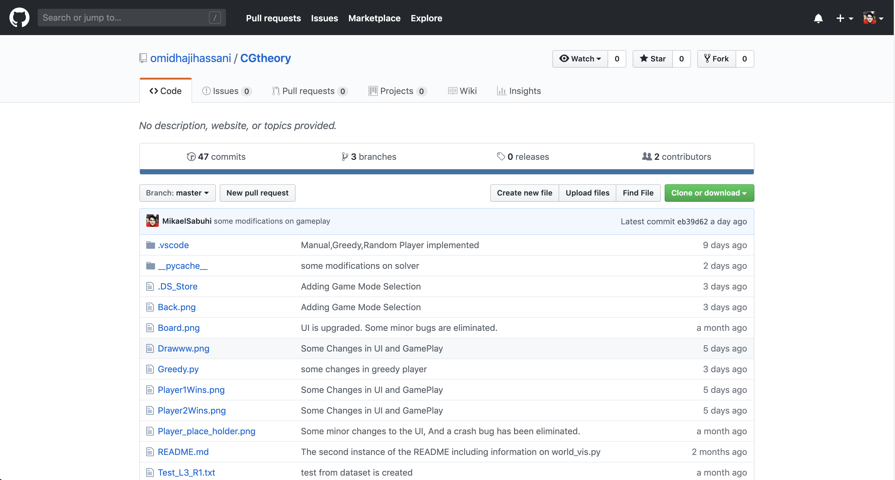
Place your screenshot here
Github Address
Check it out !
github.com/omidhajihassani/CGtheory

Slide 27
THANKS!
Any questions?

